Slide 1
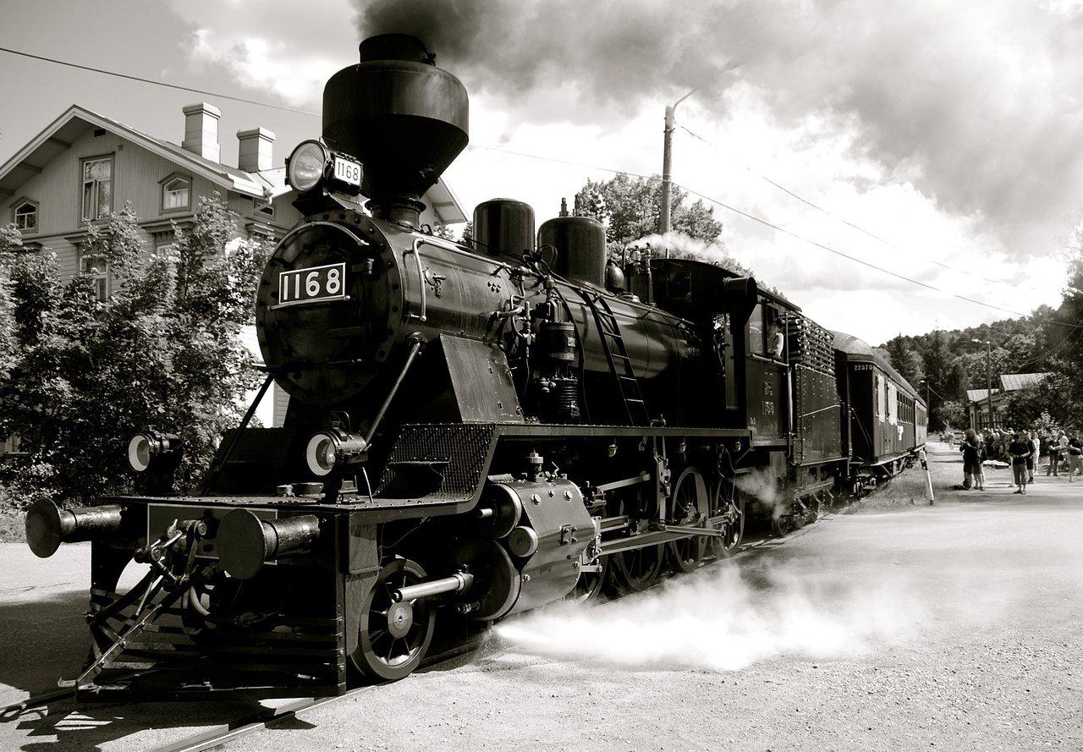
Second Industrial Revolution
Friday, January, 24, 2014

Slide 2

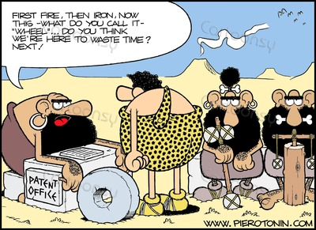
Do Now
Post a tweet advertising a new invention that will make life easier.
  What is your invention?
  How does it work?
  How will it benefit mankind?
Post
Your
Tweet!

Slide 3
Background
First Industrial Revolution
1. Changed Way Products Made: Handwork to Machinery
2. Changed Workplace: Cottages to Factories
3. Advances in transportation (steamboats, locomotives) & communication (telegraph)
Second Industrial Revolution
1. New Technology (Steel Manufacturing)
2. New Sources of Power (Oil & Electricity)

Slide 4

Second Industrial Revolution
A period of rapid growth in U.S. manufacturing in the late 1800s.
By the mid 1890s, the United States had become the world’s industrial leader.
Is this similar or different to the production of the United States today?
Why?

Slide 5
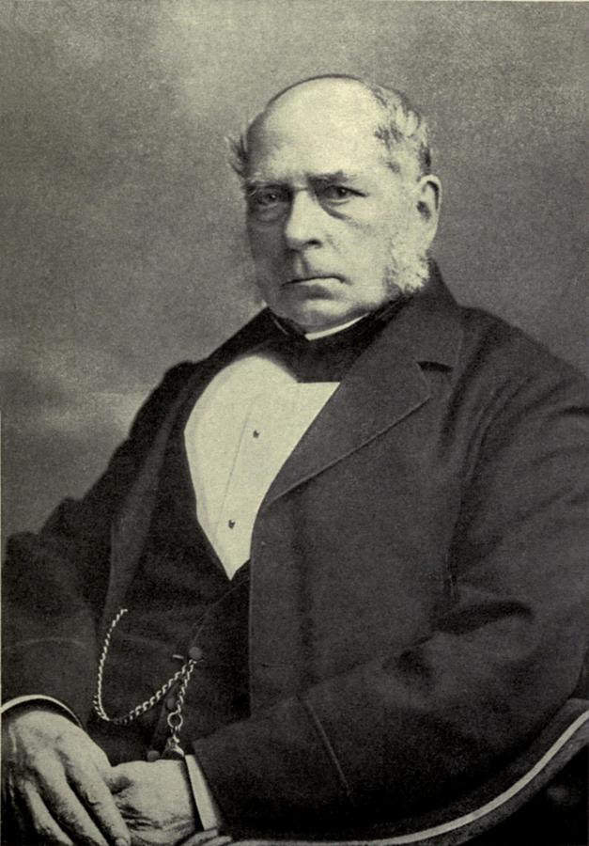
Henry Bessemer
I’ll manufacture steel quickly and cheaply
I’ll call it the Bessemer Process!

Slide 6

Bessemer Process
A way to manufacture steel quickly and cheaply by blasting hot air through melted iron to quickly remove impurities.

Slide 7
Improved passenger service with elegant passenger and sleeping cars.
Manufacturers and farmers sent products to market faster than ever before. (New refrigerator cars)
Cities where major lines crossed grew rapidly
Increased western growth by offering free tickets to settlers.
More jobs were available
Cheaper steel lowered the cost of building railroads. Companies built miles and miles of new railroads.

Slide 8
Use of Oil & Electricity as a Power Source
Oil
In the 1850s, chemists invented a way to convert crude oil into fuel called kerosene.
Kerosene could be used for cooking, heating, and lighting.
Electricity
Major source of light and power.
Edison & his team invented electric lightbulb
Suddenly, there was a demand for oil and people began searching for a reliable oil source.
Wildcatters, or prospectors drilled for oil in Ohio, Pa, and WV.
Oil companies built refineries to change the crude oil into finished products like kerosene.
Problem: few homes & buisnesses could get electricity
Solution: Edison built a power plant that supplied electricity to dozens of NYC buildings in 1882.
George Westinghouse built a power system that could send electricity across many miles.
Lit homes, businesses, factories, & powered street cars in cities across the nation

Slide 9
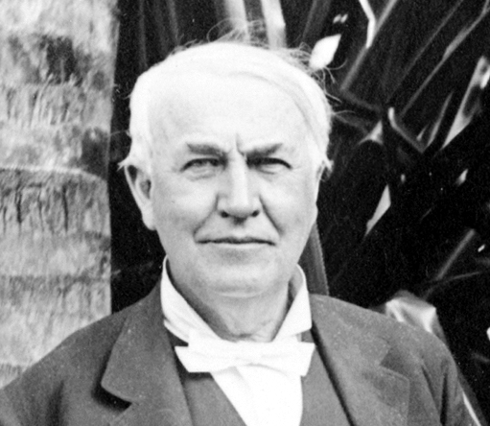
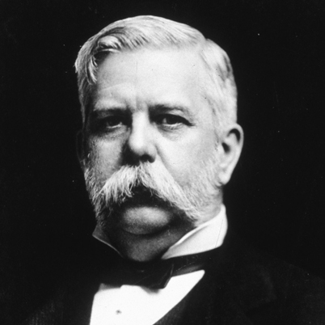
Thomas Edison George Westinghouse
Vs.

Slide 10
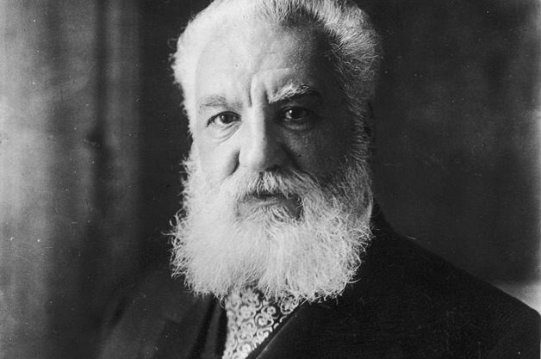
Inventions - Communication
Telegraph | Telephone
By 1861, telegraph wires connected the East and West coasts | Alexander Graham Bell patented the telephone in March 1876.
5 years later, telegraph cable ran on the floor of the Atlantic Ocean which connected the U.S. to Great Britain | Telephone companies raced to lay thousands of miles of phone lines.
Problem: telegraphs were only written messages and was difficult to use. | By 1900, there were almost 1.5 million telephones in the U.S.
I was a Scottish-born speech teacher, who studied the science of sound
I called the telephone the “talking telegraph”

Slide 11
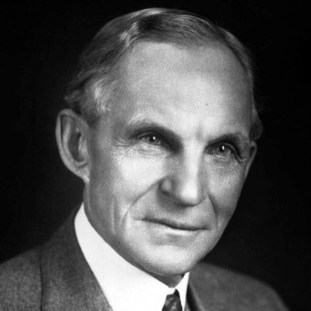
Inventions - Transportation
Henry Ford introduced the Model T car in 1908.
Early cars were expensive to build, so only wealthy people owned them
However, Ford was the 1st to use the assembly line to manufacture cars.
This reduced the cost of producing cars, thus making them more affordable.

Slide 12
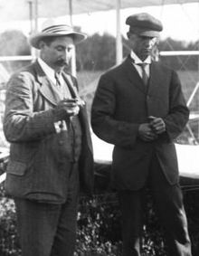
Inventions - Transportation
Wilbur & Orville Wright built a lightweight airplane that used a small gas-powered engine.
In Kitty Hawk, NC, Orville made the first piloted flight in a gas-powered plane on December 17, 1903.
Two Results:
  Changed the way people traveled in the future.
  Increase the demand for oil production.
1.
Wilbur
2.
Orville

Slide 13
Activity
Inventors Meet & Greet (15 – 20 minutes to research)
(5 minutes to greet)

Slide 14
HW
If they had Instagram during the Second Industrial Revolution…

Slide 15
Big Business
Section 2

Slide 16
DO NOW: TWITTER WALL
If you were there…It is 1895, and your town is home to a large corporation. The company’s founder and owner, a wealthy man, lives in a mansion on a hill. He is a fair employer but not especially generous. Many townspeople work in his factory. You and other town leaders feel that he should contribute more to local charities and community organizations.
Post your tweet: How could this business leader help the town more?
Notes:
Think: education, sports, etc.

Slide 17
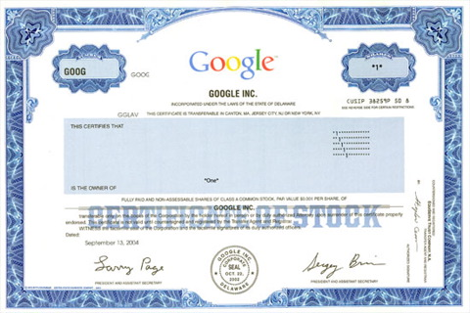
Forming Corporations
Entrepreneurs of the late 1800s established their businesses as corporations, or businesses that sell portions of ownership called stock shares.
Leaders of these corporations were the most powerful and respected people of American society at the time.

Slide 18
Generating Wealth
Successful corporations reward not only the people who own them, but the investors who hold stock, as well.
These stockholders invest their money in a corporation and based on the amount of stock they own, they would get a percentage of the corporations profits, called dividends.
Although, stockholders own a percentage of the corporation they do not run the business. The owner appoints a board of directors to elect the corporation’s main leaders, such as, the president.

Slide 19
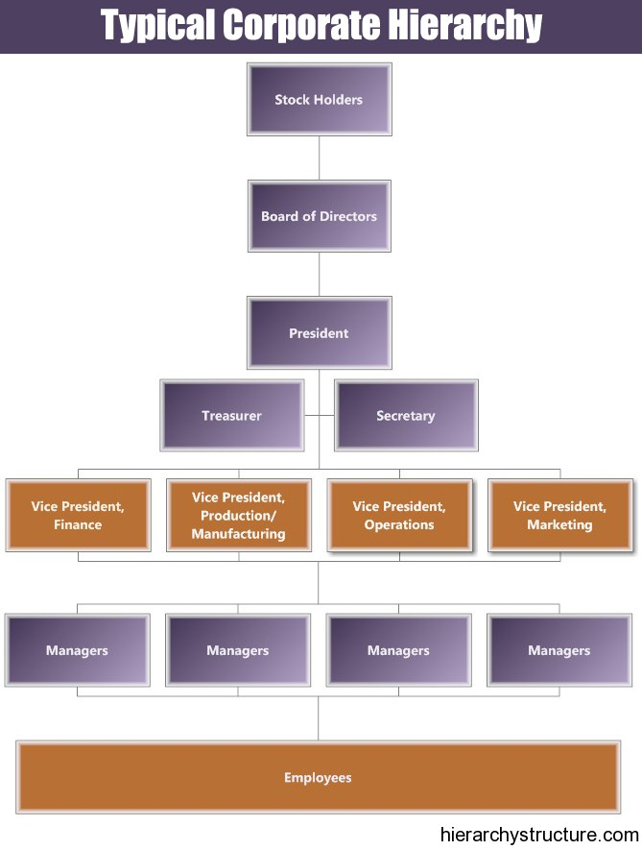

Slide 20
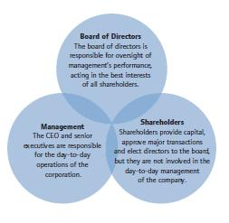

Slide 21
Advantages of Corporations
1.
Stockholders in a corporation are not responsible for business debts.
2.
If a company fails, stockholders only lose the money that they invested.
3.
Stockholders are free to sell their stock to whomever they want, whenever they want.

Slide 22
In the 1900’s the U.S. government had a “hands off” approach to the economy. They believed in a system of pure capitalism.

Slide 23
Capitalism
- Economic system in which supply and demand determine prices.
Goal of Capitalism?

Slide 24
Laissez-Faire
Government should keep its hands off of businesses

Slide 25
During the early 1900s, some Americans made their fortunes through industry

Slide 26
Entrepreneur
A person who takes a risk and starts a company.

Slide 27
Monopoly
One business has complete control of a product or service

Slide 28


Can someone explain the board game Monopoly to me?

Slide 29
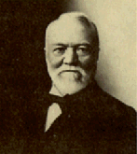
“Steel King”
Andrew
Carnegie
  Produced 80% of American steel
Poor Scottish immigrant
  $25 million per year

Slide 30
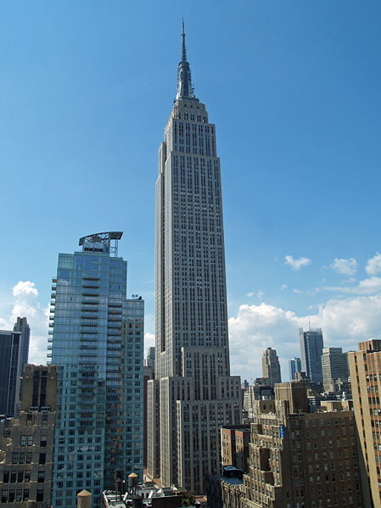
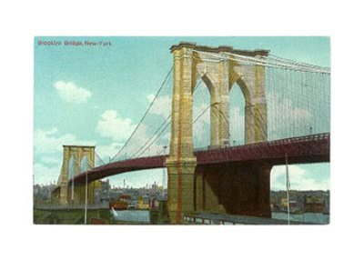
Used Bessemer Process – allowed for large skyscrapers to be built

Slide 31

Guess where Carnegie ran his business…..

Slide 32
Vertical
Consolidation
One business controls all aspects of production

Slide 33


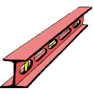

Slide 34
Philanthropist
Someone who makes charitable donations to benefit human welfare

Slide 35
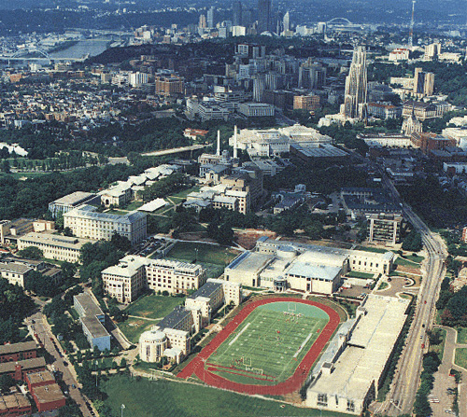
Carnegie Mellon University

Slide 36
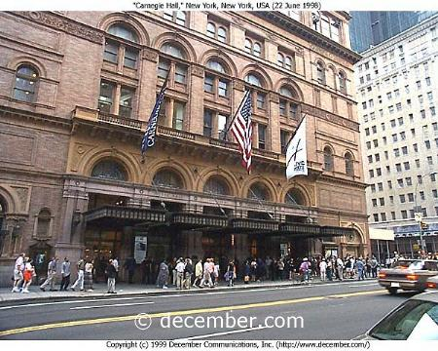
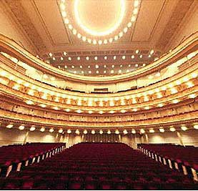
Carnegie Hall

Slide 37
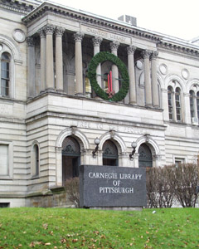
Carnegie Library

Slide 38
Merger Movement
John D. Rockefeller pioneer of the merger mov’t (Standard Oil Company)
Merger: combining many competing firms into one

Slide 39
Trusts
A group of separate companies that are placed under the control of a single board

Slide 40
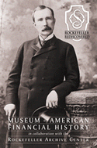
Horizontal
Consolidation
All competing companies are merged into 1 area of business

Slide 41

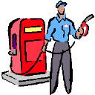

Slide 42
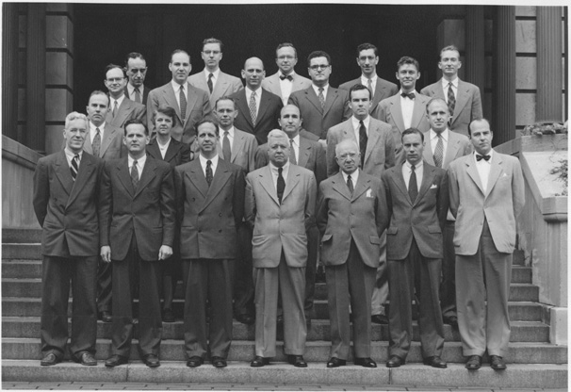
Rockefeller Institute for Medical Research

Slide 43
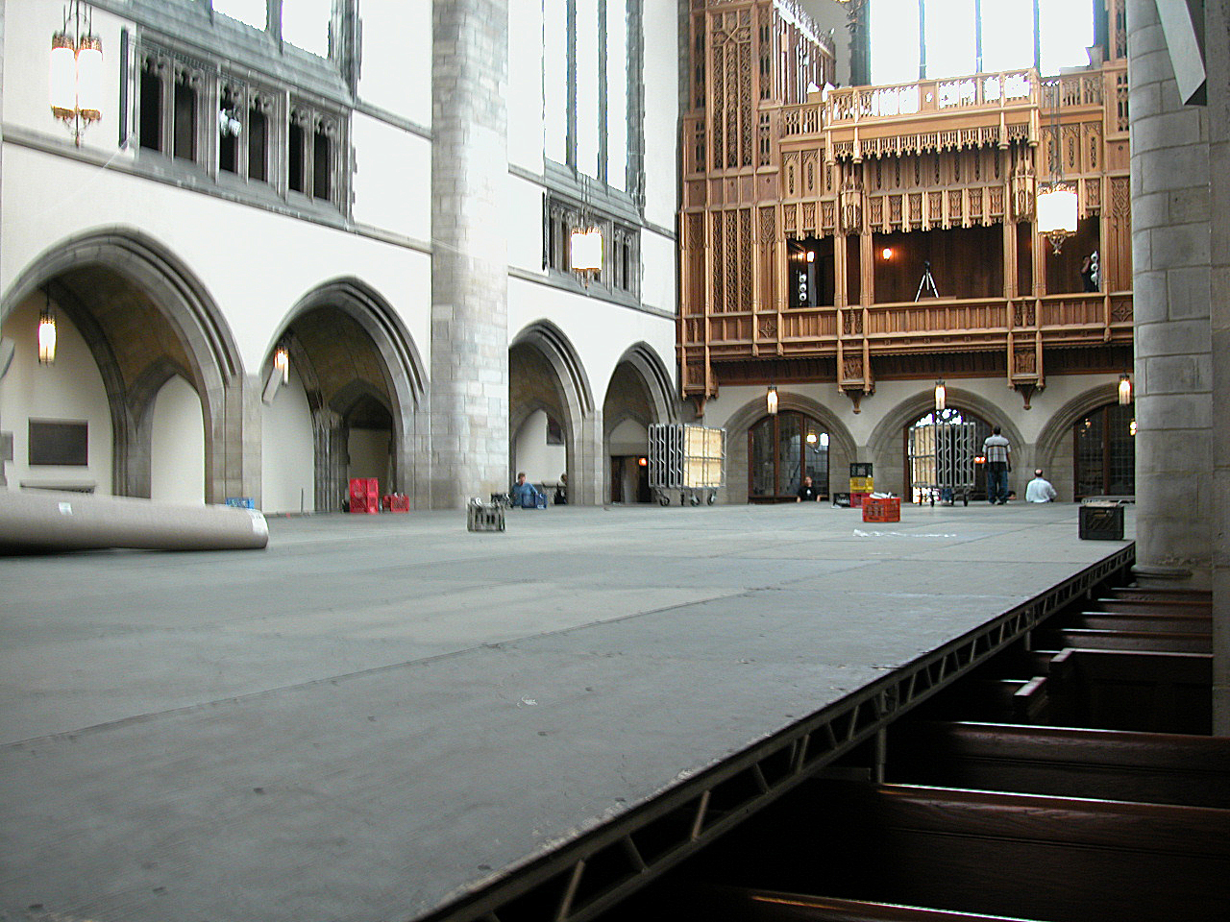
University of Chicago

Slide 44
Cornelius Vanderbilt – Steamboats, Railroads
A. Controlled the steam boat industry until selling out in 1863.
By then he was worth $40 million ($770 million now)
B. Invested in Railroads and made more money

Slide 45
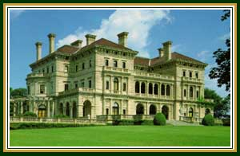
Vanderbilt

Slide 46
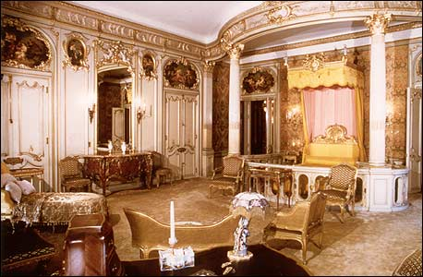
Bedroom

Slide 47
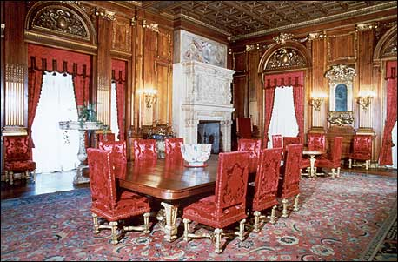
Dining room

Slide 48
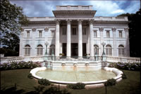
Vanderbilt summer cottage

Slide 49
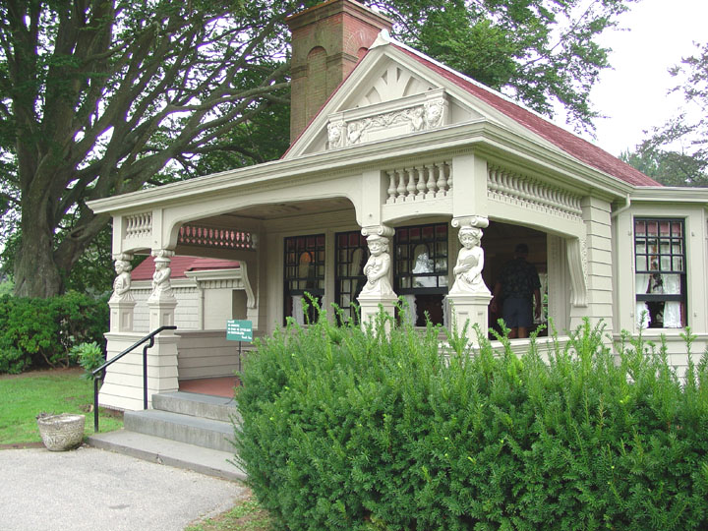
Vanderbilt childrens’ cottage

Slide 50
J.P. Morgan - banking
A. Bought the stock of companies in order to control them
B. Loaned money to companies, bought their stock, put all the businesses together and controlled them all
- example – bought the RR tracks – didn’t even have to buy the RR companies – they couldn’t travel without the tracks

Slide 51
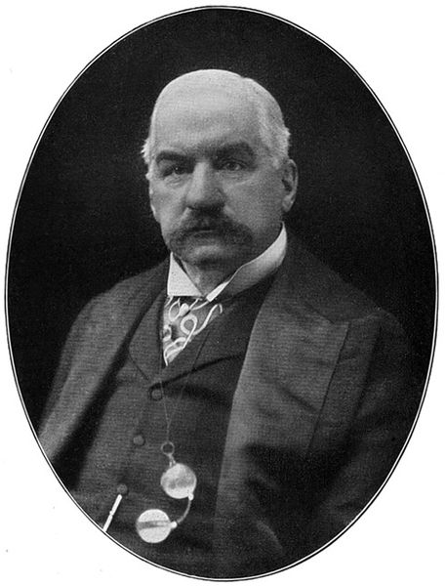
C. INCREDIBLE wealth
D. Bought Carnegie Steel for $500 million
Made it bigger – it became the first Billion dollar company

Slide 52
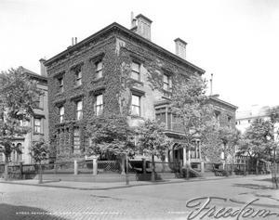
Morgan

Slide 53
Captains of Industry because they:
Increased the supply of goods
Created hundreds of jobs
Built museums and donated $

Slide 54
Or were they??????????

Slide 55
Robber Barons
Stole from the public
Drained natural resources
Controlled government
Drove small business out of business
Paid workers very little
Horrible working conditions

Slide 56
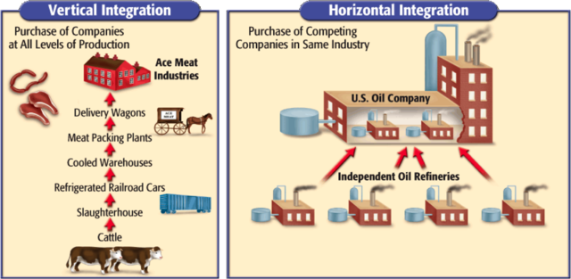
New Practices

Slide 57
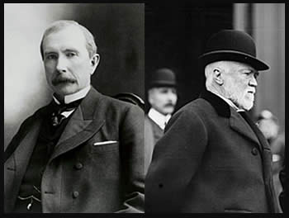

How rich were they?
Vs.
$300 billion
67 Billion

Slide 58
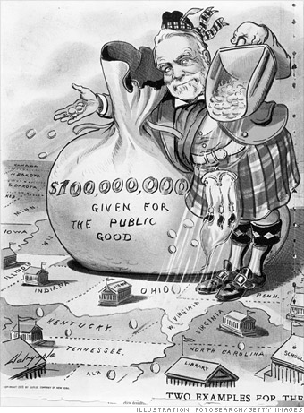
People and the government began to question the methods of big business.
People and the government began to view big business as a problem in the late 1800s.
  Concerned about child labor, low wages, and poor working conditions
Many business leaders believed in Social Darwinism.
  Darwin’s “survival of fittest” applied to which human beings would succeed in business and in life in general.
  The rich get richer, while the poor get poorer
  Fight for wealth and power – the rich survive and thrive, while the poor are neglected and deprived.
Other business leaders believed that the rich should help the poor.
  Carnegie gave $350 million to charity. Virtually, all he owned.

Slide 59
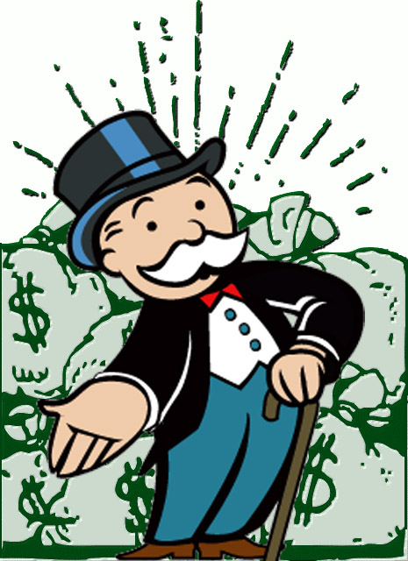
The Antitrust Movement
Critics said many businesses earned their fortunes through unfair business practices.
  Used size and strength to drive smaller competitors out of business
  Powerful trusts sold goods and services below market value until smaller competitors went out of business, then raised prices.
Some people were concerned when a trust gained a monopoly, or total ownership of a product or service.
The Sherman Antitrust Act passed in 1890 made it illegal to create monopolies or trusts that restrained trade.
  The act did not clearly define a trust in legal terms, so it was hard to enforce.
  Corporations and trusts continued to grow in size and power.

Slide 60
Modern America
Henry Ford vs. Captains of Industry – believes in competition – believed he could produce higher quality, quantity than anyone.
Revolutionized the auto industry
Supreme Court case – US v. Standard Oil – struck down Rockefeller’s monopoly. Actually, made Rockefeller even richer over $600 billion
Carnegie and Rockefeller turn to philanthropy – competition.
Vanderbilt, Carnegie, Rockefeller, Morgan, & Ford built modern America.

Slide 61
Is a monopoly fair or unfair?
In a free-market economic system, people work to make money and companies exist to make profit: individual companies want to make as much profit as possible. Certainly companies would love to be monopolies if this meant that they could make greater profits, as it most certainly would.
Without government regulation, companies that become monopolies may lower the quality of their products or services (perhaps by spending less money producing them), or they may raise the price of the goods and services that they sell.
U.S. government does not think that monopolies are good for our nation since monopolies can raise prices and lower the quality of goods and services.

Slide 62
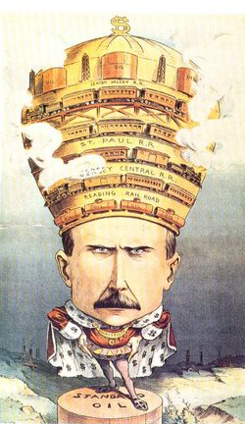
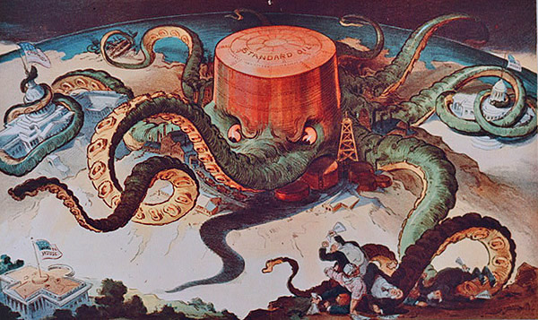
What are these political cartoons depicting? Work with elbow partner to analyze and find meaning.
1.
2.

Slide 63
“King of the World”
In 1901 Puck published this political cartoon depicting John D. Rockefeller as a king presiding over a landscape that he has devastated. On his crown are the tools of his empire: four railroads–including Pennsylvania's Reading and Lehigh Valley R.R.s– encircle his crown, which is topped by oil derricks and holding tanks.

Slide 64
“Standard Oil Octopus”
The Standard Oil Octopus is an example of the control that monopolies had over the economy and the government. This cartoon was published in 1904 during Teddy Roosevelt's presidency. The octopus is controlling the Congress (upper left building), the state capital buildings (upper right building), the shipping (upper left), the railroads (under center tentacle) and other business owner or politicians (lower right corner). The only thing not under control of the octopus is the White House. President Roosevelt is using the Sherman Anti-trust Act to regulate the monopolies. This means that there is no longer "Laissez Faire Economics."

Slide 65
Laissez-Faire Economics
1. An economic doctrine that opposes governmental regulation of or interference in commerce beyond the minimum necessary for a free-enterprise system to operate according to its own economic laws.
2. Noninterference in the affairs of others.

Slide 66
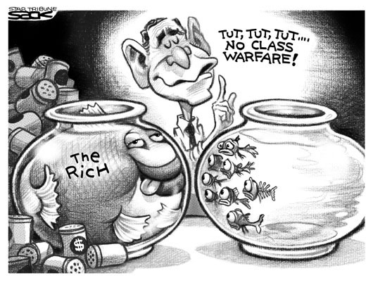
Apply Your Knowledge:
Political Cartoon Analysis
What is this political cartoon depicting? Work with your elbow partner to discuss the meaning.

Slide 67
Read & Complete Activity w/ elbow partner
Graphing & Notebook Response Questions

Slide 68
Facebook Profile
Cornelius Vanderbilt
Andrew Carnegie
John D. Rockefeller
J.P. Morgan

Slide 69

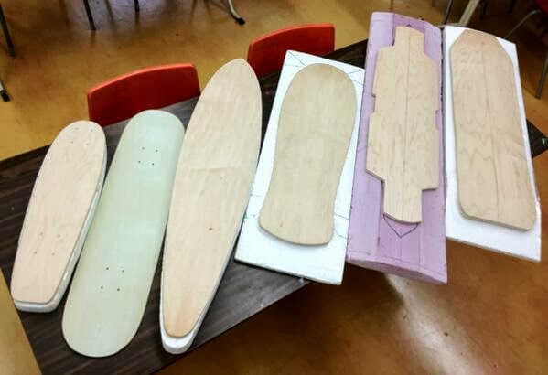
Do Now
TOC: New Practices Page 8
You are the owner of a large corporation. Your goal is to streamline your business practice using either horizontal or vertical integration. Create a diagram illustrating either one of these new practices. Be sure to include a picture of your business and/or finished product and the steps you must take to developing your monopoly. Draw at least 5 steps of either vertical or horizontal integration.
Vertical Integration
Acme Skateboards
Shaping Manufacturer
Lumber Yard
Notes:
Surfboard Example

Slide 70
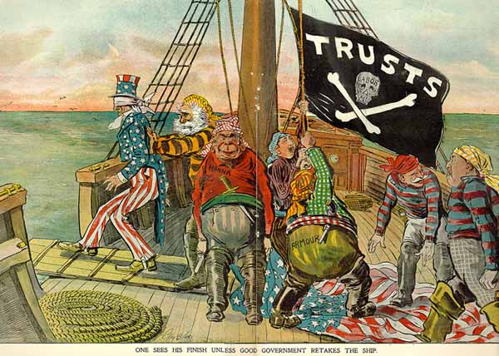
Do Now: Answer Questions About Cartoon

Slide 71
Interpreting Political Cartoons
What is your interpretation of this political cartoon?
Who do the pirates represent?
What do “Uncle Sam” and the American flag represent?
What is happening to “Uncle Sam” and the American flag?
Why is labor the skull in the “Jolly Rogers” flag?
What could happening during this period, 1880-1910 that would inspire such a political cartoon?

Slide 72
Do Now: YouTube Video (Labor Day)

Slide 73
Assembly Line Simulation
Job: creating high-quality paper dolls
Step 1: Draw the best, most detailed picture of a boy/girl doll that you can.
Step 2: Divide class into 4 groups (pick the best doll)
Step 3: Assign drawing parts for each person in the group.
Step 4: Produce as many high-quality pictures you can in 10 minutes.

Slide 74
Debriefing – Evaluate your experience
Notebook
• How did you feel working as a craftsperson at the beginning of this activity?
• How did you feel working on the assembly line?
• What factors made producing the drawing on the assembly line difficult
or frustrating?
• How did members of your group cope with the stress or monotony?
• What made you want to work hard? What made you not want to work hard?
• How did you feel about the the factory manager?
• How did your attitude or feelings change as the activity progressed?
• Did you prefer working as an individual craftsperson or working on the
assembly line? Explain

Slide 75
T-Chart Compare & Contrast (Left Side)
The Reality of the Assembly Line
Directions:
After reading the passage, complete the following T-chart that compares your assembly line experience to what assembly lines were like during the Industrial Revolution.
One side will tell you what you actually did in the simulation the other will tell how it was during the Industrial Revolution. You need to cover conditions, rules, environment, and experience.
Come up with at least eight corresponding ideas.

Slide 76
Advantages & Disadvantages Matrix (Left Side)

Slide 77
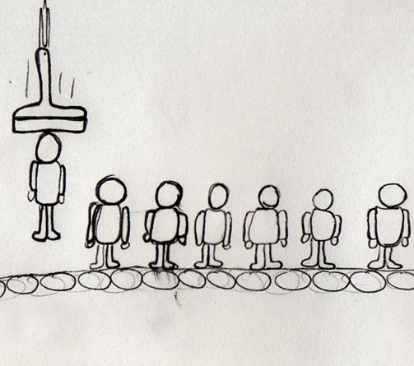
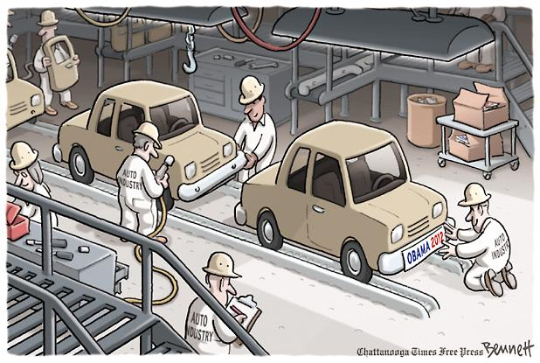
Assignment (Right Side)
Draw a 2 panel cartoon comparing their classroom experience with the realistic experience of assembly work. Use thought bubbles to describe what the workers were feeling at the time.
Classroom Experience | Historical Reality

Slide 78
Do Now: Notecard
Describe a time when you were unhappy with certain conditions—at home, work, or school. How did you try to change those conditions? Were you successful? Why or why not?
Afterward, share your response with a classmate or the class.

Slide 79
Preview
In this lesson, you will learn about
the working class at the turn of the
20th century.
You will explore
  the working and living conditions that prompted workers to unite and fight for better conditions and pay.
  the formation of early labor unions.
  some of the successes and failures of those unions.

Slide 80
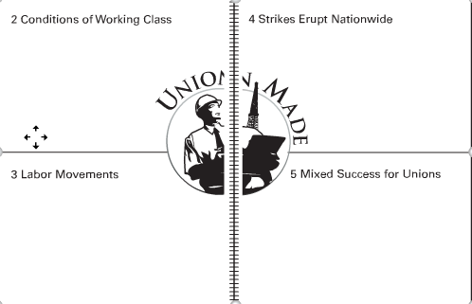
Notebook – Pages 11 & 12
TOC: Labor Unions

Slide 81
Assignments
Section 2
Record at least four details describing the working and living conditions of industrial workers.
Section 3
Record at least two strategies labor unions employed in their attempt to improve workers’ lives. Then record at least two ways employers attempted to undermine unions.
Section 4
Record at least three key events during the labor movement of this time period. Summarize each event in three or four sentences.
Section 5
Record at least three important losses or gains that labor unions experienced during this time. Write at least one sentence explaining each gain or loss.

Slide 82
Green/Pink Game

